Slide 1
Classification using Logistic Regression

Slide 2
Logistic Regression
Supervised classification algorithm.
In a classification problem, the target variable(or output), y, can take only discrete values for given set of features(or inputs), X.
We can also say that the target variable is categorical.
Logistic Regression
Dependent variable is binary: 1(True, Success) and 0(False, Failure)
Goal is to find best fitting model for independent and dependent variable relationship.
Independent variables can be continuous or binary.

Slide 3
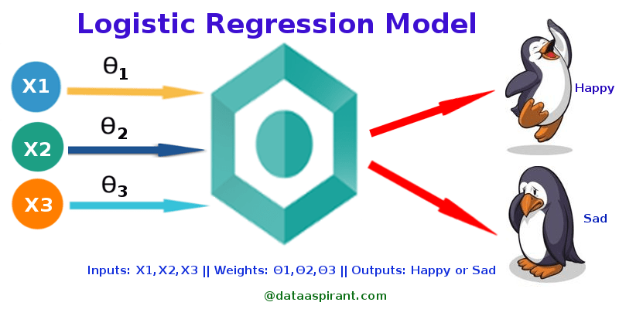
Graphical Representation: Logistic Regression

Slide 4
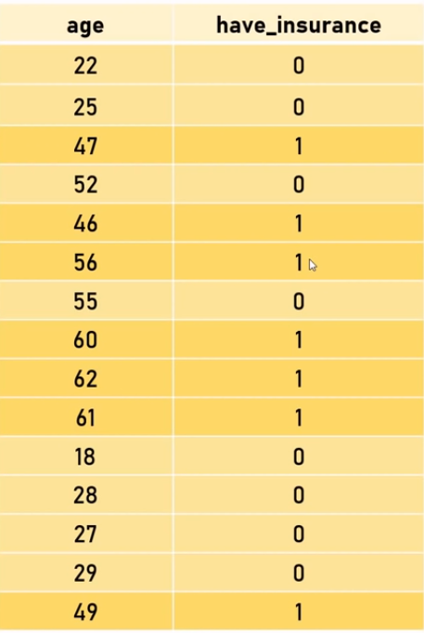
Insurance Data

Slide 5
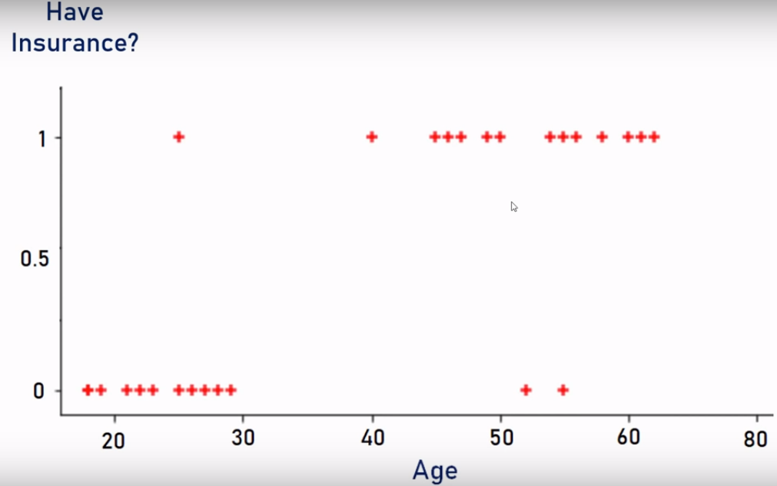

Slide 6
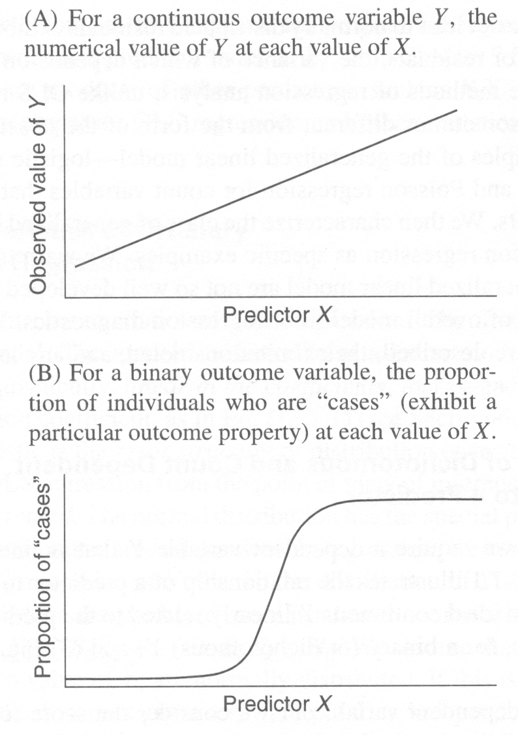
Logistic Regression vs Linear Regression

Slide 7
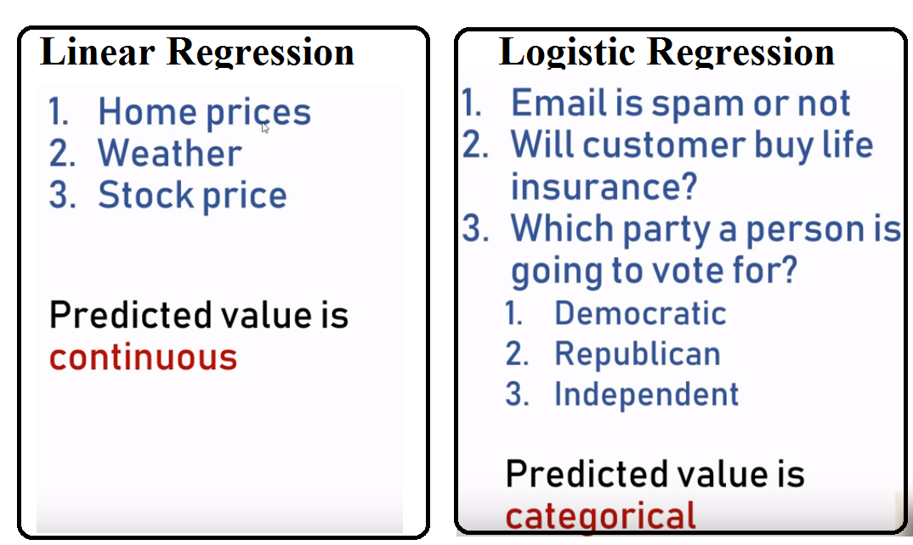

Slide 8
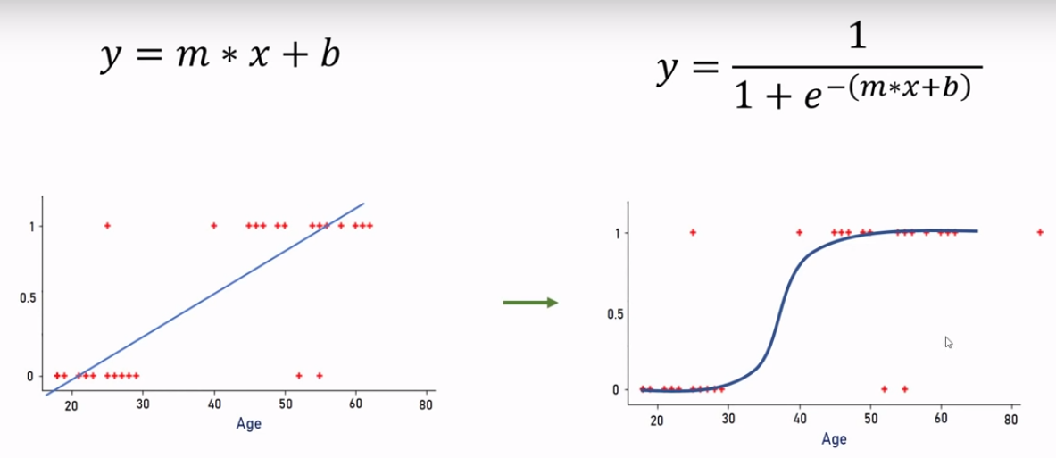
Logistic Regression
Sigmoid function convers input range 0 to 1
e= Euler’s number~2.71828

Slide 9
Types of Logistic Regression
Binomial:
Target variable can have only 2 possible types: “0” or “1” which may represent “win” vs “loss”, “pass” vs “fail”, “dead” vs “alive”, etc.
Multinomial:
Target variable can have 3 or more possible types which are not ordered(i.E. Types have no quantitative significance) like “disease A” vs “disease B” vs “disease C”.
Ordinal:
It deals with target variables with ordered categories. For example, a test score can be categorized as:“very poor”, “poor”, “good”, “very good”. Here, each category can be given a score like 0, 1, 2, 3.

Slide 10
Thanks

